Slide 1
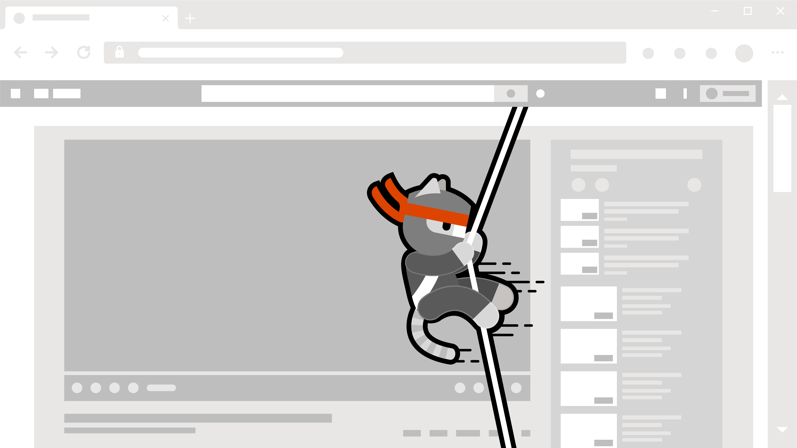
Hacking Containers
Applications & Docker

Slide 2
Eng Teong Cheah
Microsoft MVP

Slide 3
Applications
Containers have slowly taken the place of virtual machines in many environments
There is a tradeoff currently between containers and virtual machines – one that we can easily exploit.
Virtual machines bring a layer of security into the application by virtualizing the hardware layers.
This abstraction means that an operating system kernel, drivers, memory management, and file system must be provided each time a virtual machine is created.

Slide 4
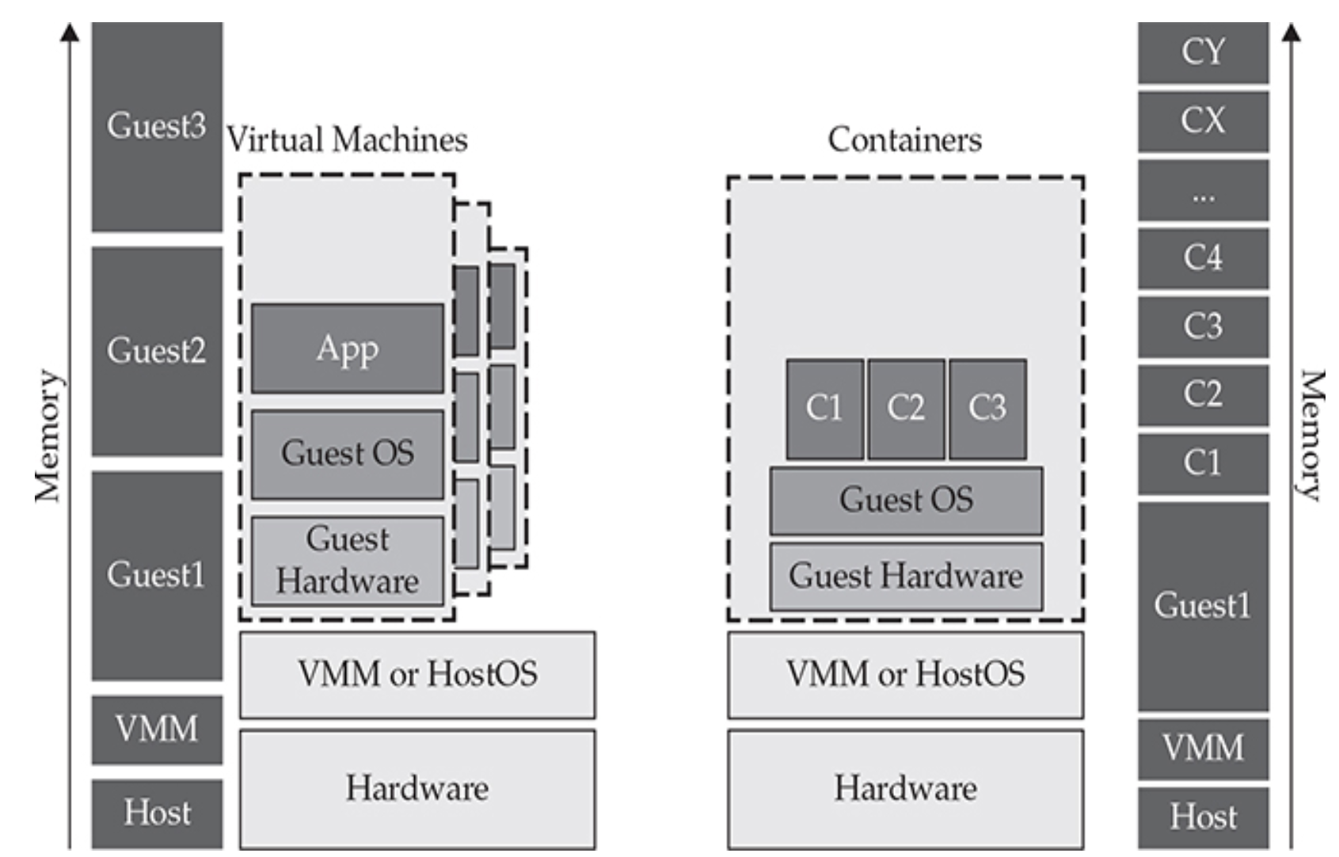
Applications
Containers are different; they bring over the userland binaries and share the operating system kernel, drivers, and memory structures.
The demarcation or isolation is at the container group and namespaces layer.

Slide 5
What Is Docker?
Docker is not a Container Runtime Interface (CRI).
Docker open-sourced its container runtime interface knowns as ContainerD.
The Docker daemon usually runs in a Linux socket, but not always.
Seaching on popular Internet search tools will yield many open and exposed Docker daemons.
In essence, Docker ends up being a wrapper command or an API layer that orchestrator that allows an administrator to orchestrate multiple containers on the same box.

Slide 6
Demo
Looking for Docker Daemons

Slide 7
References
Gray Hat Hacking, Sixth Edition

